Slide 1
Dynamic web crawler
Ishan SachAdeva (110128118)
Neha singh (110127511)
Mohammad YAHiYA KHAN (110126053)

Slide 2
What is the problem?
In the world of Artificial Intelligence, we need a smart web crawler that uses two methods: Breadth-First Search (BFS) and Depth-First Search (DFS). The challenge is to build a crawler that can decide when to use BFS or DFS, making it efficient and fast while using resources wisely. The main problem is creating a crawler that can explore the internet effectively, finding the right information. This crawler should be adaptable, balancing between looking at a lot of things broadly and digging deep into specific areas of the internet. The goal is to make a flexible web crawler that not only shows the strength of BFS and DFS in AI but also meets the needs of real-world situations, helping in getting information, analyzing data, and improving artificial intelligence applications

Slide 3
WHY THIS PROBLEM SHOULD BE SOLVED?
Challenges in web crawling
Importance of efficient algorithms
Scale and Volume:
Vastness of the web requires efficient strategies to process a massive number of pages.
Dynamic Content:
Dynamic and ever-changing web content necessitates adaptability in crawling approaches.
Politeness and Fairness:
Ensuring politeness to web servers and fair usage of resources adds complexity to crawling.
Duplicate Content:
Identifying and handling duplicate content is crucial for data accuracy and storage efficiency.
Recrawling:
Efficiently determining when and what to recrawl to maintain up-to-date information.
Timeliness:
Efficient algorithms contribute to timely retrieval and indexing of new content.
Resource Optimization:
Optimal utilization of computational and bandwidth resources is essential for scalability.
Avoiding Redundancy:
Efficient traversal minimizes redundant crawling, saving bandwidth and storage.
Scalability:
Scalable algorithms enable the crawler to handle the increasing size of the web.
Adaptability:
Ability to adapt to diverse web structures and content types for comprehensive coverage.

Slide 4
What the team wants to achieve?
Develop a web crawler capable of systematically traversing and indexing a diverse range of web pages.
Improve the efficiency of web crawling operations, ensuring timely retrieval and indexing of content.
Create a crawler that adapts to different web structures and scales effectively with the growth of web content.

Slide 5
Literature review
Sr. No. | Research Paper/Book | Publication & Publication date | Authors | Abstract
1 | The Anatomy of a Large-Scale Hypertextual Web Search Engine | 1998 | Sergey Brin and Larry Pag | This seminal paper introduces the PageRank algorithm, which marked a significant milestone in the development of search engines
2 | Information Retrieval in High Dimensional Spaces | 1979 | C. J. van Rijsbergen | this early work delves into graph-based algorithms and information retrieval
3 | Crawling the Web: Discovery and Maintenance of Large-Scale Web Data | 1999 | Soumen Chakrabarti, Byron Dom, and Piotr Indyk | Crawling the Web: Discovery and Maintenance of Large-Scale Web Data.
4 | Efficient Crawling Through URL Ordering | 2002 | Junghoo Cho and Hector Garcia-Molina | The paper emphasizes the importance of ordering URLs efficiently during the crawling process to enhance the overall efficiency of the web crawler
5 | Analytical Results on the BFS vs. DFS Algorithm Selection Problem: Part II: Graph Search | 2015 | Tom Everitt & Marcus Hutter | The paper addresses the algorithm selection problem, specifically comparing breadth-first search (BFS) and depth-first search (DFS) in graph search applications.
6 | Adaptive on-line page importance computation | Proceedings of the 12th international conference on World Wide Web | 2003 | Serge Abiteboul , Mihai Preda & Gregory Cobena | The adaptive nature of the algorithm allows for efficient and timely updates in page importance, reflecting the changing relevance of web pages.
7 | Learning to crawl: Comparing classification schemes | 2005 | Gautam Pant & Padmini Srinivasan | The study aims to understand and evaluate the effectiveness of various classification approaches in the context of learning to crawl the web.
8 | Comparative Analysis of Various Uninformed Searching Algorithms in AI | 2019 | Gayathri R | The study systematically assesses and contrasts various uninformed search algorithms, aiming to discern their individual strengths, weaknesses, and performance characteristics

Slide 6
Evolution of breadth first search and depth first search
Graph Traversal Algorithms (Mid-20th Century)
Maze Solving and Puzzles (1970s)
Network Flow Problems (1970s-1980s)
Artificial Intelligence (1980s)
Web Crawling and Search Engines (1990s)
Social Network Analysis (2000s)
Optimization Problems (2010s)
Algorithmic Game Theory (Recent Years)
Machine Learning and Pattern Recognition (Recent Years)

Slide 7
Key Insights
Graph Traversal Algorithms (Mid-20th Century):
Insight: Foundation for efficient graph exploration.
Relevance: Basis for versatile web crawlers.
Maze Solving and Puzzles (1970s):
Insight: Adaptability beyond traditional domains.
Relevance: Applicable problem-solving for dynamic web crawling.
Network Flow Problems (1970s-1980s):
Insight: Optimization of resource allocation.
Relevance: Enhancing efficiency in web crawling.
Artificial Intelligence (1980s):
Insight: Learning, adaptation, intelligent decision-making.
Relevance: Basis for adaptive web crawlers.
Web Crawling and Search Engines (1990s):
Insight: Efficient exploration of the interconnected web.
Relevance: BFS, DFS crucial for web crawler development.

Slide 8
Key Insights
6. Social Network Analysis (2000s):
Insight: Understanding relationships in large networks.
Relevance: Extracting meaningful context in web content
7. Optimization Problems (2010s):
Insight: Applying algorithms for process streamlining.
Relevance: Optimization principles for improved crawling.
8. Algorithmic Game Theory (Recent Years):
Insight: Strategic decision-making and competitiveness.
Relevance: Considering dynamics in dynamic web environments.
9. Machine Learning and Pattern Recognition (Recent Years):
Insight: Advances in data-driven insights.
Relevance: Enhancing web crawlers through pattern recognition.

Slide 9
Our approach
Strategy Overview: BFS
Comprehensive Exploration:
Strategy Overview: DFS
In-Depth Exploration:
Connection to Webcrawling
Dynamic Adaptability:
BFS, with its level-by-level exploration, ensures a thorough and systematic coverage of the web pages. This is crucial for applications such as indexing or data extraction where a broad but shallow search is beneficial.
Shortest Path for Crawling:
The algorithm's nature allows us to prioritize the discovery of the shortest paths between pages. This is valuable for minimizing redundancy and optimizing the crawler's efficiency.
On the other hand, DFS offers a more in-depth exploration of specific branches of the web. This is advantageous when the goal is to deeply analyze specific content, such as for sentiment analysis or in-depth content understanding.
Memory Efficiency:
DFS is often more memory-efficient compared to BFS, making it suitable for scenarios where resource consumption is a critical factor.
By combining BFS and DFS strategically, our web crawler can dynamically adapt its traversal strategy based on the characteristics of the web pages. BFS for breadth and DFS for depth, providing a balanced and adaptable approach.
Optimal Resource Utilization:
The choice of BFS and DFS aligns with the resource constraints inherent in web crawling scenarios. This ensures optimal utilization of computational resources while maintaining the crawler's effectiveness.

Slide 10
Experiment design
Variables
Seed URL: Vary the starting point for crawling
Maximum Crawl Depth: Test different crawl depths to observe the impact on performance.
Metrics
Measure the overall time taken for the web crawling process.
Assess the efficiency of the crawler in processing individual pages.
Search Keywords: Experiment with different sets of keywords relevant to the target content.
Adaptive Features: Evaluate the impact of switching from BFS to DFS and the effectiveness of keyword tracking and page ranking.
Analyze the accuracy of keyword tracking in the crawled content.
Evaluate the effectiveness of the page ranking mechanism.

Slide 11
Experimental PROCEDURE
Run the web crawler with different combinations of seed URLs, maximum crawl depths, and search keywords.
Record the total time taken, average time per page, keyword frequencies, and page ranks for each experiment.
Experiment with both BFS and DFS modes and observe the impact on crawl efficiency.
Analyze how changes in crawl depth affect the performance of the web crawler.
Adjust the set of search keywords to test the adaptability of the keyword tracking mechanism.

Slide 12
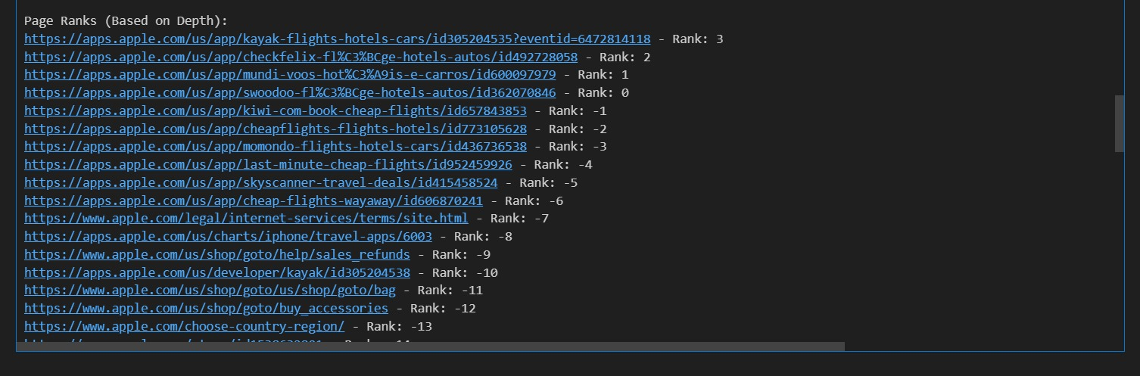

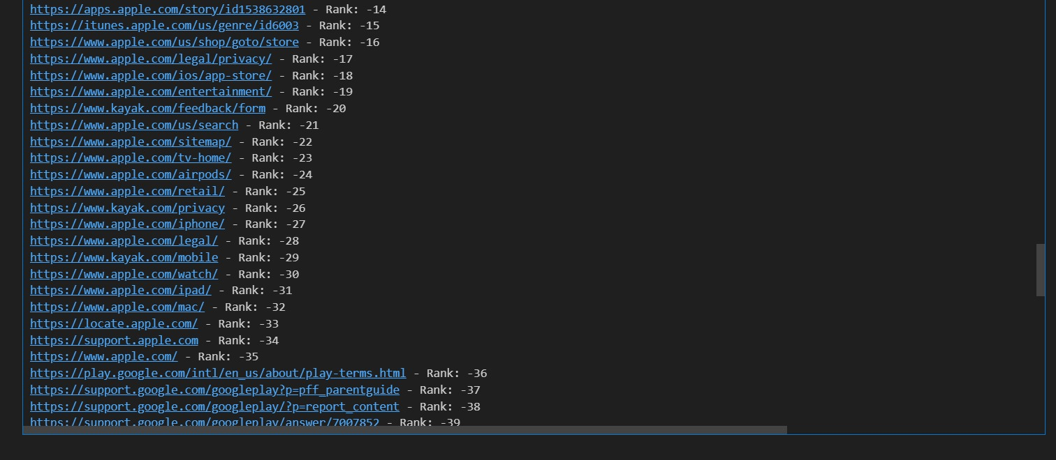

Output

Slide 13
Final Result
the primary seed URL is https://kayak.com, and subsequent URLs are discovered through the crawling process. The choice of seed URL can impact the focus and relevance of the crawled pages. In this case, the focus is on travel-related content, particularly flights and hotels.

Slide 14
BFS vs. DFS Performance
BFS (Breadth-First Search):
Pros:
Covers a broad range of topics quickly.
Good for discovering a variety of content.
Cons:
May not deeply explore specific topics.
DFS (Depth-First Search):
Pros:
Focuses on specific topics deeply.
Can uncover detailed information on a particular subject.
Cons:
May miss relevant content in other areas.
Performance in terms of Time:
The crawl uses a hybrid approach with BFS for the first level and DFS for subsequent levels.
The total time taken is 112.96 seconds, with an average time per page of 0.98 seconds.
The hybrid approach balances breadth and depth, optimizing for efficiency.
Adaptability:
The hybrid approach is adaptable, combining the advantages of both BFS and DFS.
It efficiently explores the broader landscape while ensuring in-depth coverage of specific areas.

Slide 15
Influence of Crawl Depth
Observations:
Depth influences page ranks, with depth 1 having the highest rank.
Different depths reveal different levels of information, from main pages to specific content.
Recommendations:
Adjusting crawl depth can tailor the focus of the crawl.
Shallower depths may capture general information, while deeper depths can uncover specific details

Slide 16
Keyword Tracking and Page Ranks
Accuracy of Keyword Tracking:
Keyword frequencies indicate a strong focus on travel-related terms.
The top keywords include "travel," "flight," "hotel," "price," "search," "holiday," and "destination."
Correlation with Page Ranks:
Higher-ranked pages are likely more central or important in the context of the website.
Correlating page ranks with keyword frequencies helps identify key topics.
Recommendations:
Further analysis can validate the correlation between page ranks and content relevance.
Evaluate the effectiveness of keyword tracking in capturing the main themes of the crawled content.

Slide 17
Summary of Key Findings and Achievements
Reiteration of the Significance of the Project
Our project addresses the critical need for dynamic web crawling strategies, recognizing the limitations of static approaches in an internet environment characterized by constant updates and changes.
The significance lies in the project's ability to harness BFS and DFS, providing an intelligent solution that adapts to the dynamic nature of web content, ensuring relevance and timeliness in information retrieval.
Throughout our project, we delved into the dynamic realm of web crawling, utilizing the powerful algorithms of Breadth-First Search (BFS) and Depth-First Search (DFS).
Key findings include the adaptability of BFS and DFS for dynamic content, real-time decision-making, and the effective prioritization of content in an ever-changing web landscape.

Slide 18
References
S. Brin and L. Page, "The Anatomy of a Large-Scale Hypertextual Web Search Engine," Computer Networks, vol. 30, pp. 107-117, 1998. [Online]. Available:Computer Networks, vol. 30, pp. 107-117, 1998. [Online]. Available: http://www-db.stanford.edu/ backrub/google.htmlhttp://www-db.stanford.edu/ backrub/google.html
Jin, J.S. (2003). Indexing and Retrieving High Dimensional Visual Features. In: Feng, D.D., Siu, WC., Zhang, HJ. (eds) Multimedia Information Retrieval and Management. Signals and Communication Technology. Springer, Berlin, Heidelberg. https://doi.org/10.1007/978-3-662-05300-3_8.
Chawla, A. (2013). CRAWLING THE WEB: DISCOVERY AND MAINTENANCE OF LARGE-SCALE WEB DATA. International Journal of Advances in Engineering Sciences, 3, 62-66.
J. Cho, H. Garcia-Molina, and L. Page, "Efficient crawling through URL ordering," Computer Networks and ISDN Systems, vol. 30, no. 1-7, pp. 161-172, 1998.Computer Networks and ISDN Systems, vol. 30, no. 1-7, pp. 161-172, 1998. ISSN: 0169-7552, doi: 10.1016/S0169-7552(98)00108-1. [Online]. Available:ISSN: 0169-7552, doi: 10.1016/S0169-7552(98)00108-1. [Online]. Available: https://www.sciencedirect.com/science/article/pii/S0169755298001081https://www.sciencedirect.com/science/article/pii/S0169755298001081.
Everitt, T., Hutter, M. (2015). Analytical Results on the BFS vs. DFS Algorithm Selection Problem: Part II: Graph Search. In: Pfahringer, B., Renz, J. (eds) AI 2015: Advances in Artificial Intelligence. AI 2015. Lecture Notes in Computer Science(), vol 9457. Springer, Cham. https://doi.org/10.1007/978-3-319-26350-2_15.
S. Abiteboul, M. Preda, and G. Cobena, "Adaptive on-line page importance computation," in Proceedings of the 12th International Conference on World Wide Web (WWW ’03),in Proceedings of the 12th International Conference on World Wide Web (WWW ’03), New York, NY, USA, 2003, pp. 280-290.New York, NY, USA, 2003, pp. 280-290. DOI: 10.1145/775152.775192. [Online]. Available:DOI: 10.1145/775152.775192. [Online]. Available: https://doi.org/10.1145/775152.775192https://doi.org/10.1145/775152.775192.
G. Pant and P. Srinivasan, "Learning to crawl: Comparing classification schemes," ACM Trans. Inf. Syst., vol. 23, no. 4, pp. 430-462, Oct. 2005.ACM Trans. Inf. Syst., vol. 23, no. 4, pp. 430-462, Oct. 2005. DOI: 10.1145/1095872.1095875. [Online]. Available:DOI: 10.1145/1095872.1095875. [Online]. Available: https://doi.org/10.1145/1095872.1095875https://doi.org/10.1145/1095872.1095875
R. Gayathri, "Comparative Analysis of Various Uninformed Searching Algorithms in AI," IJCSMC, vol. 8, no. 6, pp. 57-65, 2019.IJCSMC, vol. 8, no. 6, pp. 57-65, 2019.

Slide 19
THANK YOU

